Slide 1
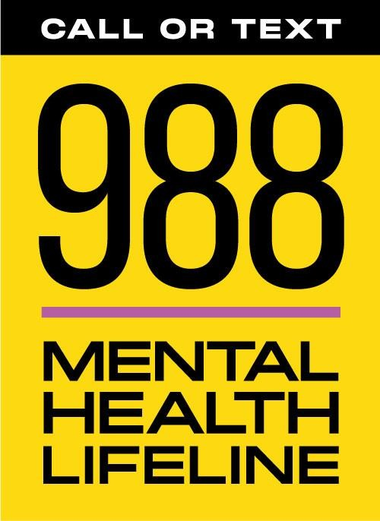
oklahoma.gov/odmhsas
8

Slide 3
CURRENT STATE OF CRISIS
4.1% of adults in Oklahoma had serious thoughts of suicide in the past year.
1 in 10 students reporting attempting suicide in the past 12 months.
Each week, approximately 300 Oklahomans are admitted for urgent care or crisis mental health services.

Slide 4
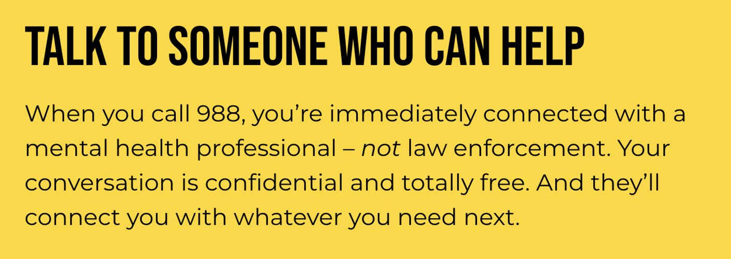

Slide 5
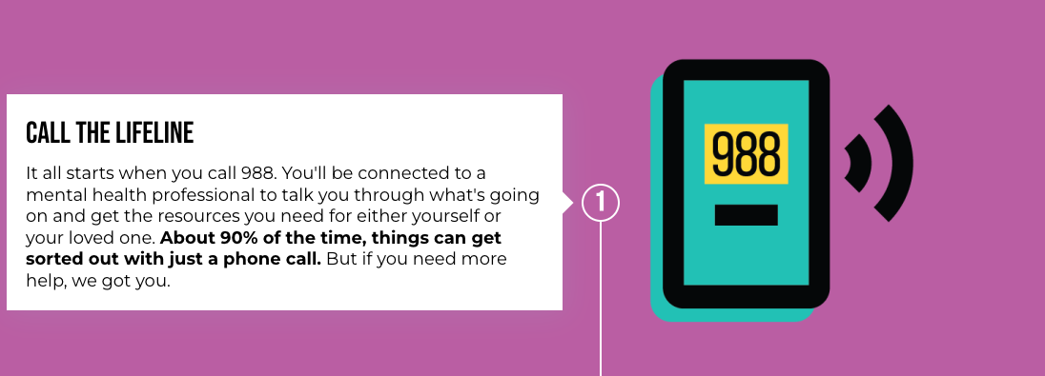
How it works:

Slide 7
Mobile Crisis Teams.
What Are Mobile Crisis Teams?
Respond locally within the community to deescalate crisis situations.
A team includes a licensed clinician and certified peer recovery support specialist or case manager.
Utilizes best practices in behavioral health, including suicide prevention and intervention.
Mobile teams are dispatched by 988 Lifeline and response to crisis situations 24/7 for anyone in need.

Slide 8
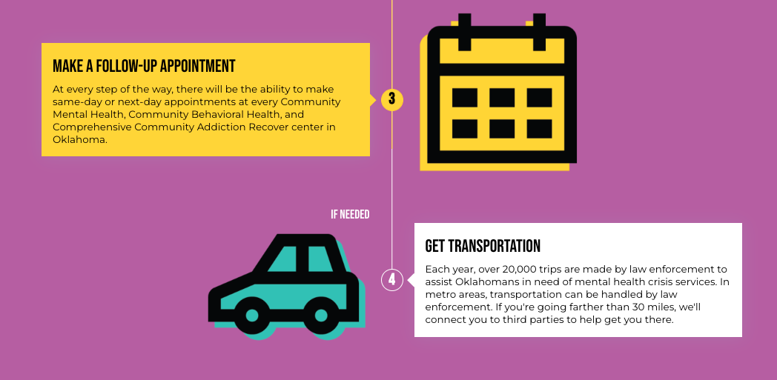

Slide 9
Urgent Recovery & Crisis Centers
Urgent Care and Crisis Centers:
A place of stabilization
Offer a no wrong door access to mental health and substance use care
Includes models for children, youth and family services!
Operation of these facilities are similar to a hospital emergency department that accepts all walk-ins, ambulance, fire and police drop-offs.
These facilities provide assessment and support, and are staffed 24/7/365 with a multidisciplinary team. This team includes but is not limited to psychiatrists, nurses, licensed behavioral health practitioners and peers with lived experience similar to the population served.

Slide 10
It’s Working
The 988 Mental Health Lifeline has answered more than 38,000 calls, responded to more than 10,000 texts and dispatched more than 5,000 mobile crisis teams since July 5, 2022 launch!
Top Ten Status
Metrics around Oklahoma’s 988 launch prove we are one of the most sucessful response systems in the country, meeting people where they’re at, when they need it most.

Slide 11
Visit 988oklahoma.com for more information.
Follow @odmhsas and @988okla on social media!

